Slide 1
Omnify graphs presentation
Kotni Kanaka Raju

Slide 2
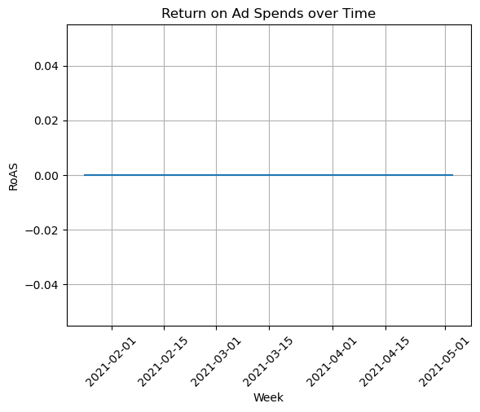
Assuming you have a 'date' column in your DataFrame that contains the dates of ad spends

Slide 3
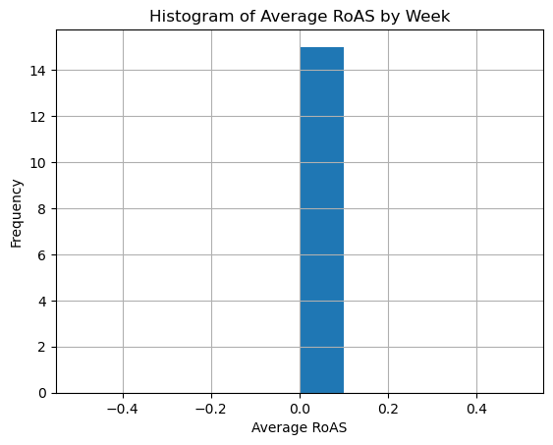
Histogram analysis

Slide 4
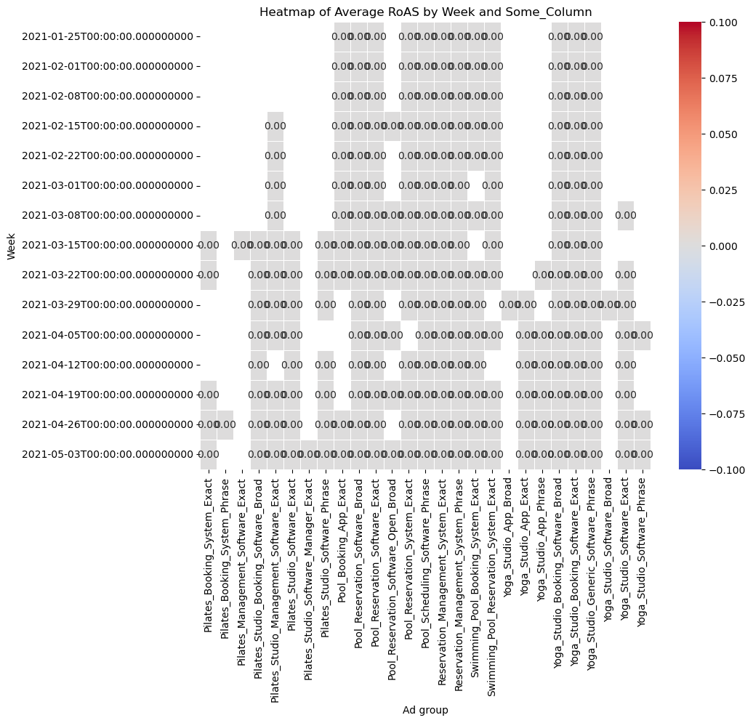
# Assuming 'Week' is a numeric column, if not, you might need to encode it to numeric values

Slide 5
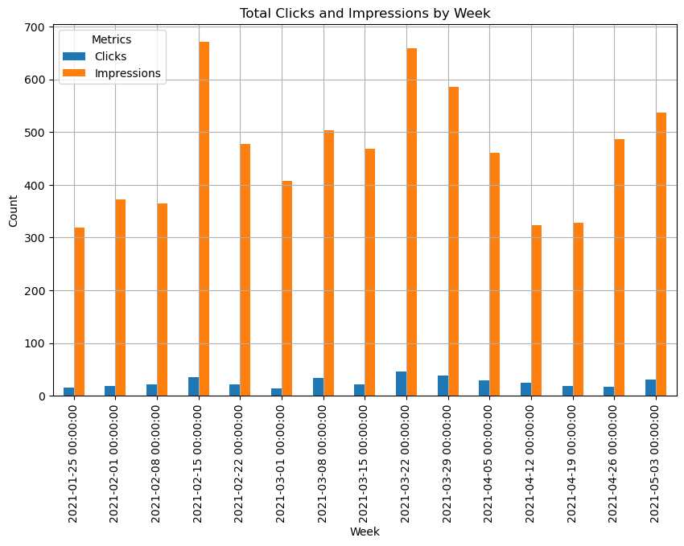
Total clicks and impressions by week

Slide 6
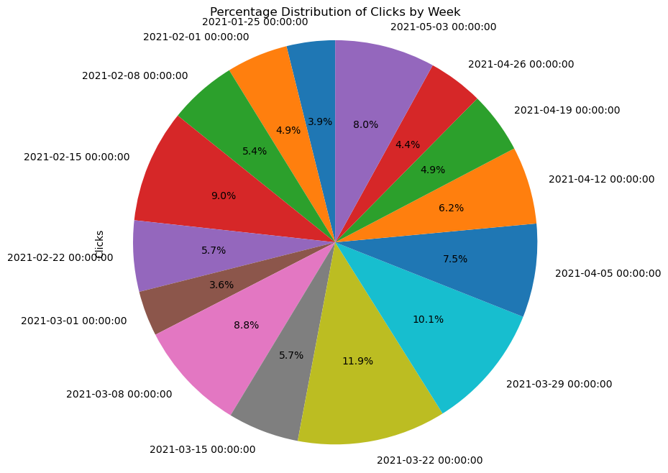

Slide 7
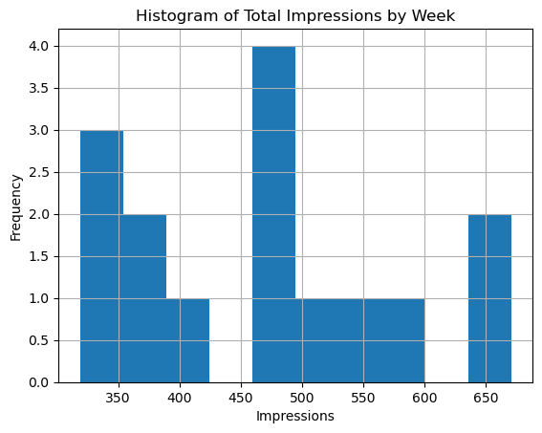

Slide 8
